Slide 1
CSE 409 Digital Signal Processing
Professor Dr. Md. Sujan Ali
Dept. of Computer Science and Engineering
Jatiya Kabi Kazi Nazrul Islam University
Trishal, Mymensingh, Bangladesh

Slide 2
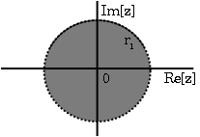
The Z-Transform

Slide 3

“তোমার কাছে যা অপ্রীতিকর অন্যের প্রতি তা প্রয়োগ কর না”
- মহাভারত

Slide 4
What is Z-Transform?
In mathematics and signal processing, the Z-transform converts a discrete-time signal, which is a sequence of real or complex numbers, into a complex frequency-domain representation.
It has wide range of applications in mathematics and digital signal processing.
It is mainly used to analyze and process digital data.

Slide 5
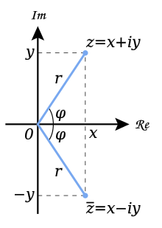
What is Z in Z transform?
‘z' is any point in the z-plane. In mathematics, the complex plane or z-plane is a geometric representation of the complex numbers established by the real axis and the perpendicular imaginary axis.
Geometric representation of z and its conjugate z̅ in the complex plane. The distance along the light blue line from the origin to the point z is the modulus or absolute value of z. The angle φ is the argument of z.

Slide 6
Z-Transform
The Fourier transform of a discrete time signal is defined as:
provided is absolutely summable:
Obviously some signals may not satisfy this condition and their Fourier transform do not exist.
To overcome this difficulty, we can multiply the given exponential function by certain values of the real parameter r so that may be forced to be summable .

Slide 7
Z-Transform
Now the discrete time Fourier transform becomes:
The z-transform of a discrete-time signal x(n) is defined by
Where is a complex variable. The values of z for which the sum converges define a region in the z-plane referred to as the region of convergence (ROC).

Slide 8
The z-transform and the DTFT
The z-transform is a function of the complex z variable
If we plot z=e^{jω} for ω=0 to 2π we get the unit circle
Im
Unit Circle
r=1
ω
0
Re
ω
2π
0
2π

Slide 9
Convergence of the z-Transform
DTFT does not always converge
Complex variable z can be written as r e^{jω} so the z-transform
DTFT of x[n] multiplied with exponential sequence r ^{-n}
For certain choices of r the sum maybe made finite

Slide 10
Region of Convergence
The set of values of z for which the z-transform converges
Each value of r represents a circle of radius r
The region of convergence is made of circles
Im
Example: z-transform converges for values of 0.5<r<2
ROC is shown on the left
In this example the ROC includes the unit circle, so DTFT exists
Re

Slide 11
Example
Im
For Convergence we require
Inside the ROC series converges to
a
1
o
x
Re
Region outside the circle of radius a is the ROC
Clearly, X(z) has a zero at z = 0 and a pole at z = a.

Slide 12
Properties of The ROC of Z-Transform
The ROC is a ring or disk centered at the origin
DTFT exists if and only if the ROC includes the unit circle
The ROC cannot contain any poles.
By definition a pole is a where X(z) is infinite. Since X(z) must be finite for all z for convergence, there cannot be a pole in the ROC.

Slide 13
Properties of The ROC of Z-Transform
If x[n] is a finite-duration sequence, then the ROC is the entire z-plane, except possibly z=0 or |z|=∞.
A finite-duration sequence is a sequence that is nonzero in a finite interval n1≤n≤n2.
As long as each value of x[n] is finite then the sequence will be absolutely summable.
When n2>0 there will be a z-1 term and thus the ROC will not include z=0. When n1<0 then the sum will be infinite and thus the ROC will not include |z|=∞.
On the other hand, when n2≤0 then the ROC will include z=0, and when n1≥0 the ROC will include |z|=∞.
With these constraints, the only signal, then, whose ROC is the entire z-plane is x[n]=cδ[n].

Slide 14
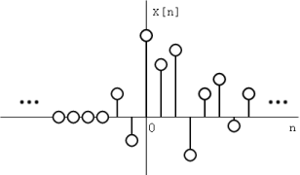
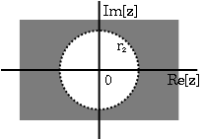
Properties of The ROC of Z-Transform
If x[n] is a right-sided sequence, then the ROC extends outward from the outermost pole in X(z).
A right-sided sequence is a sequence where x[n]=0 for n<n1<∞.
Figure : A right-sided sequence.
Figure : The ROC of a right-sided sequence

Slide 15
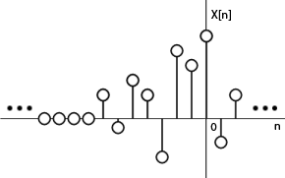
Properties of The ROC of Z-Transform
If x[n] is a left-sided sequence, then the ROC extends inward from the innermost pole in X(z).
A left-sided sequence is a sequence where x[n]=0 for n>n2>−∞.
Figure : A left-sided sequence.
Figure : The ROC of a left-sided sequence.

Slide 16
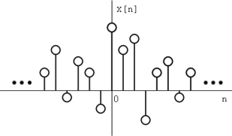
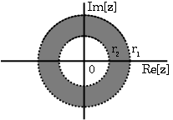
Properties of The ROC of Z-Transform
If x[n] is a two-sided sequence, the ROC will be a ring in the z-plane that is bounded on the interior and exterior by a pole.
A two-sided sequence is an sequence with infinite duration in the positive and negative directions. From the derivation of the above two properties, it follows that if -r2<|z|<r2 converges, then both the positive-time and negative-time portions converge and thus X(z) converges as well. Therefore the ROC of a two-sided sequence is of the form -r2<|z|<r2.
Figure 6: A two-sided sequence.
Figure : The ROC of a two-sided sequence.

Slide 17
Example: A right sided Sequence
x(n)
. . .
n
-8
-7
-6
-5
-4
-3
-2
-1
1
2
3
4
5
6
7
8
9
10

Slide 18
Example: A right sided Sequence
For convergence of X(z), we require that

Slide 19
Example: A right sided Sequence ROC for x(n)=a^{n}u(n)
Im
ROC is bounded by the pole and is the exterior of a circle.
1
−a
a
Re

Slide 20
Example: A left sided Sequence
-8
-7
-6
-5
-4
-3
-2
-1
1
2
3
4
5
6
7
8
9
10
n
. . .
x(n)

Slide 21
Example: A left sided Sequence
For convergence of X(z), we require that

Slide 22
Example: A left sided Sequence ROC for x(n)=−a^{n}u(− n−1)
Im
ROC is bounded by the pole and is the interior of a circle.
1
−a
a
Re

Slide 23
Example: Sum of Two Right Sided Sequences
Im
ROC is bounded by poles and is the exterior of a circle.
1/12
−1/3
1/2
Re
ROC does not include any pole.

Slide 24
Example: A Two Sided Sequence
Im
ROC is bounded by poles and is a ring.
1/12
−1/3
1/2
Re
ROC does not include any pole.

Slide 25
Z-Transform (Exercise)
Determine the z-transform and ROC of the signals

Slide 26
Example
Find the z-transform and ROC of the sequence
x(n)= {1,0,3,-1,2}
Solution:
The z-transform of a discrete-time signal x(n) is defined by
From (1), we get
X(z)=x(0) + x(1)z⁻¹ + x(2)z⁻² + … …(2)
The sequence values are x(0)=1; x(1)=0; x(2)=3; x(3)= -1; x(4)=2
Subtituting these values in equation (2) we have
X(z)=1 + 3z⁻² - z⁻³ + 2z⁻⁴
The X(z) converges for all values of z except at z=0.

Slide 27
Properties of the z-transform
Linearity
Overlay of
the above two
ROC’s

Slide 28
Properties of the z-transform
Shift

Slide 29
Multiplication by an Exponential Sequence
Properties of the z-transform

Slide 30
Differentiation of X(z)
Properties of the z-transform

Slide 31
Conjugation
Properties of the z-transform

Slide 32
Reversal
Properties of the z-transform

Slide 33
Real and Imaginary Parts
Properties of the z-transform

Slide 34
Convolution of Sequences
Properties of the z-transform

Slide 35
Convolution of Sequences
Properties of the z-transform

Slide 36
The Inverse Z Transform
The inverse z transform can be defined as;
x(n)=Z⁻¹X(Z)
where x(n) is the signal in time domain and X(Z) is the signal in frequency domain.
If we want to represent the above equation in integral format then we can write it as
x(n)=(1/2Πj)∮X(Z)Z^{n−1}dz
Here, the integral is over a closed path C. This path is within the ROC of the x(z) and it does contain the origin.

Slide 37
The Inverse Z Transform
Given a Z domain function, there are several ways to perform an inverse Z Transform:
Long Division
Direct Computation
Partial Fraction Expansion with Table Lookup
Direct Inversion
Using Transform Equation

Slide 38

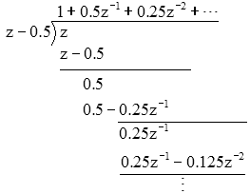
Inverse Z Transform by Long Division
To understand how an inverse Z Transform can be obtained by long division, consider the function
If we perform long division

Slide 39
Inverse Z Transform by Long Division
we can see that
So the sequence f[k] is given by
Upon inspection

Slide 40
Inverse Z Transform by Long Division
Find the inverse z-transform of

Slide 41
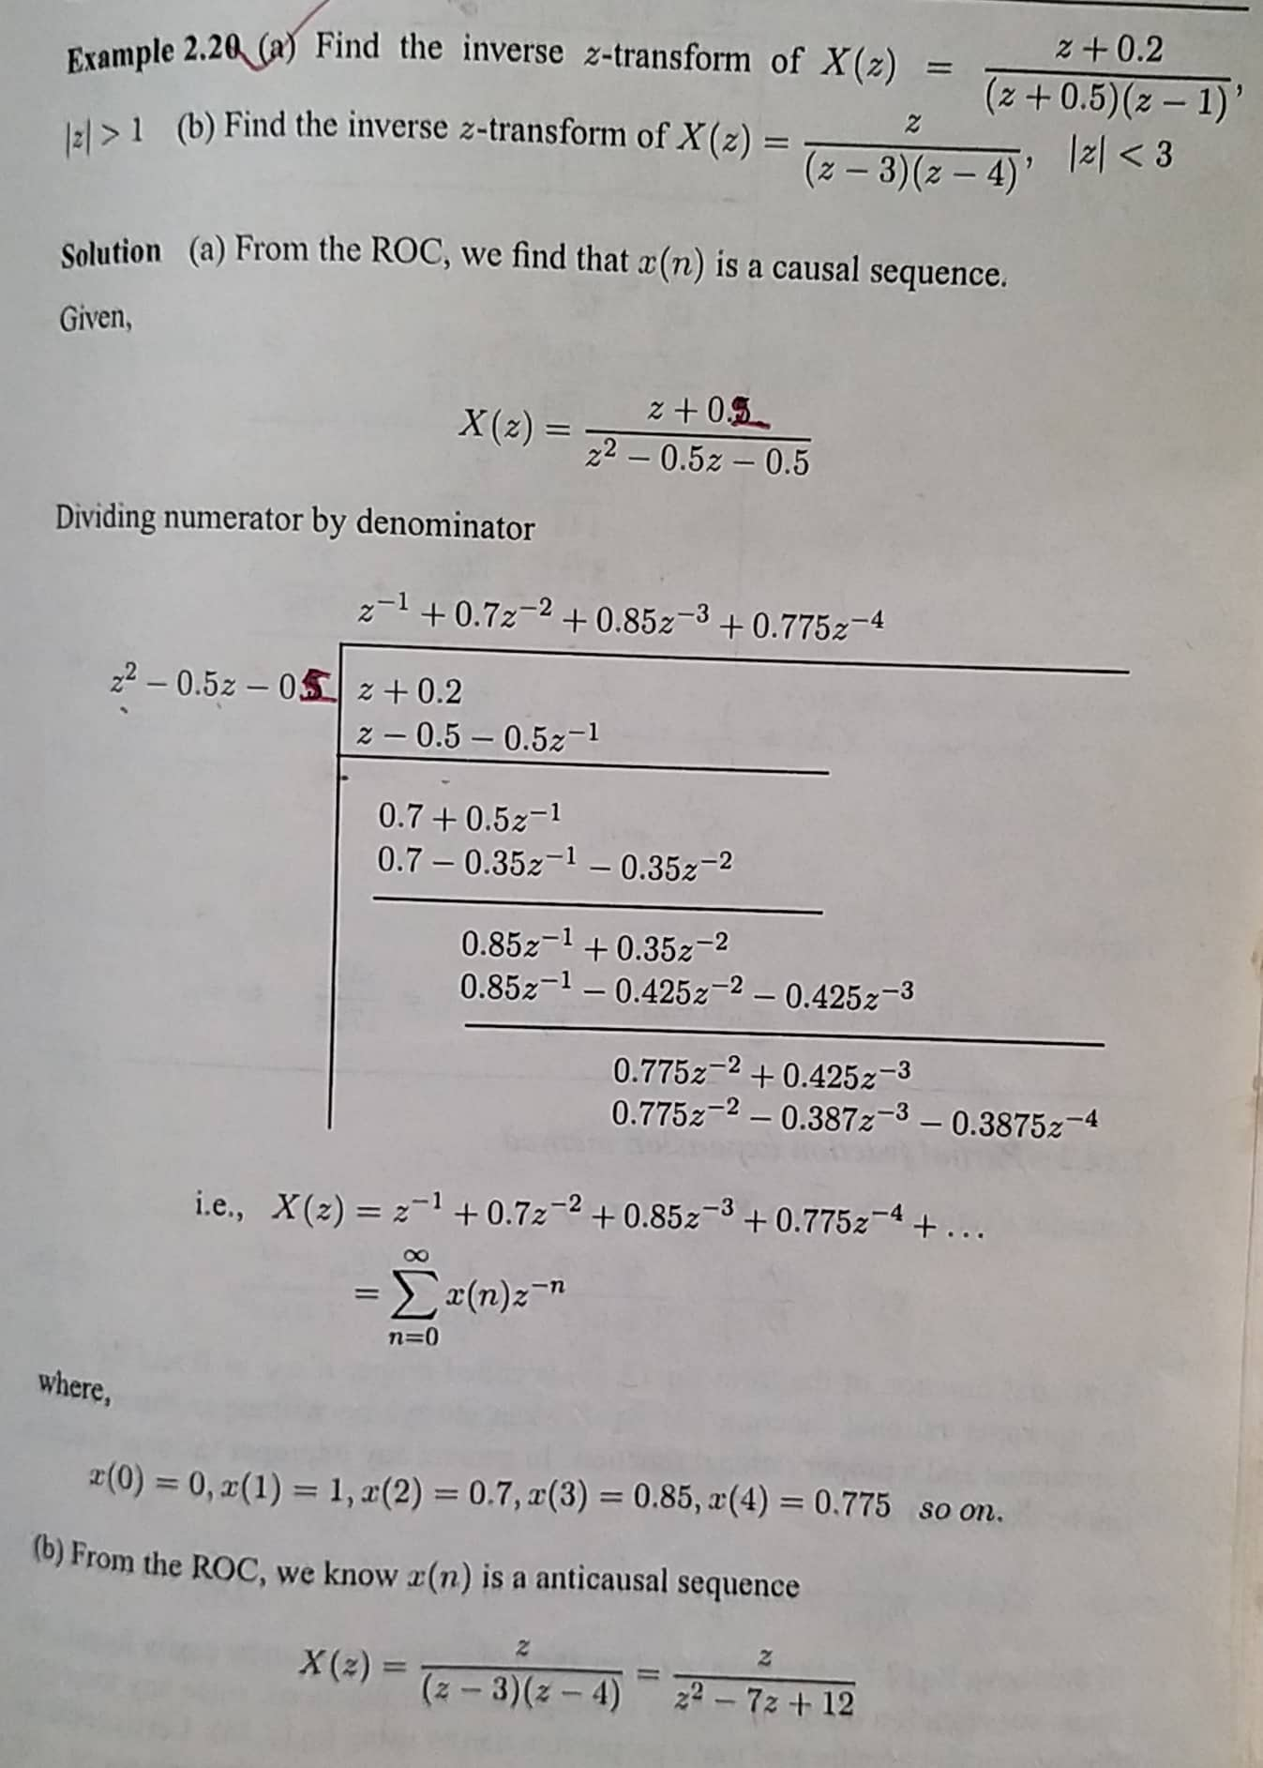
Inverse Z Transform by Long Division

Slide 42
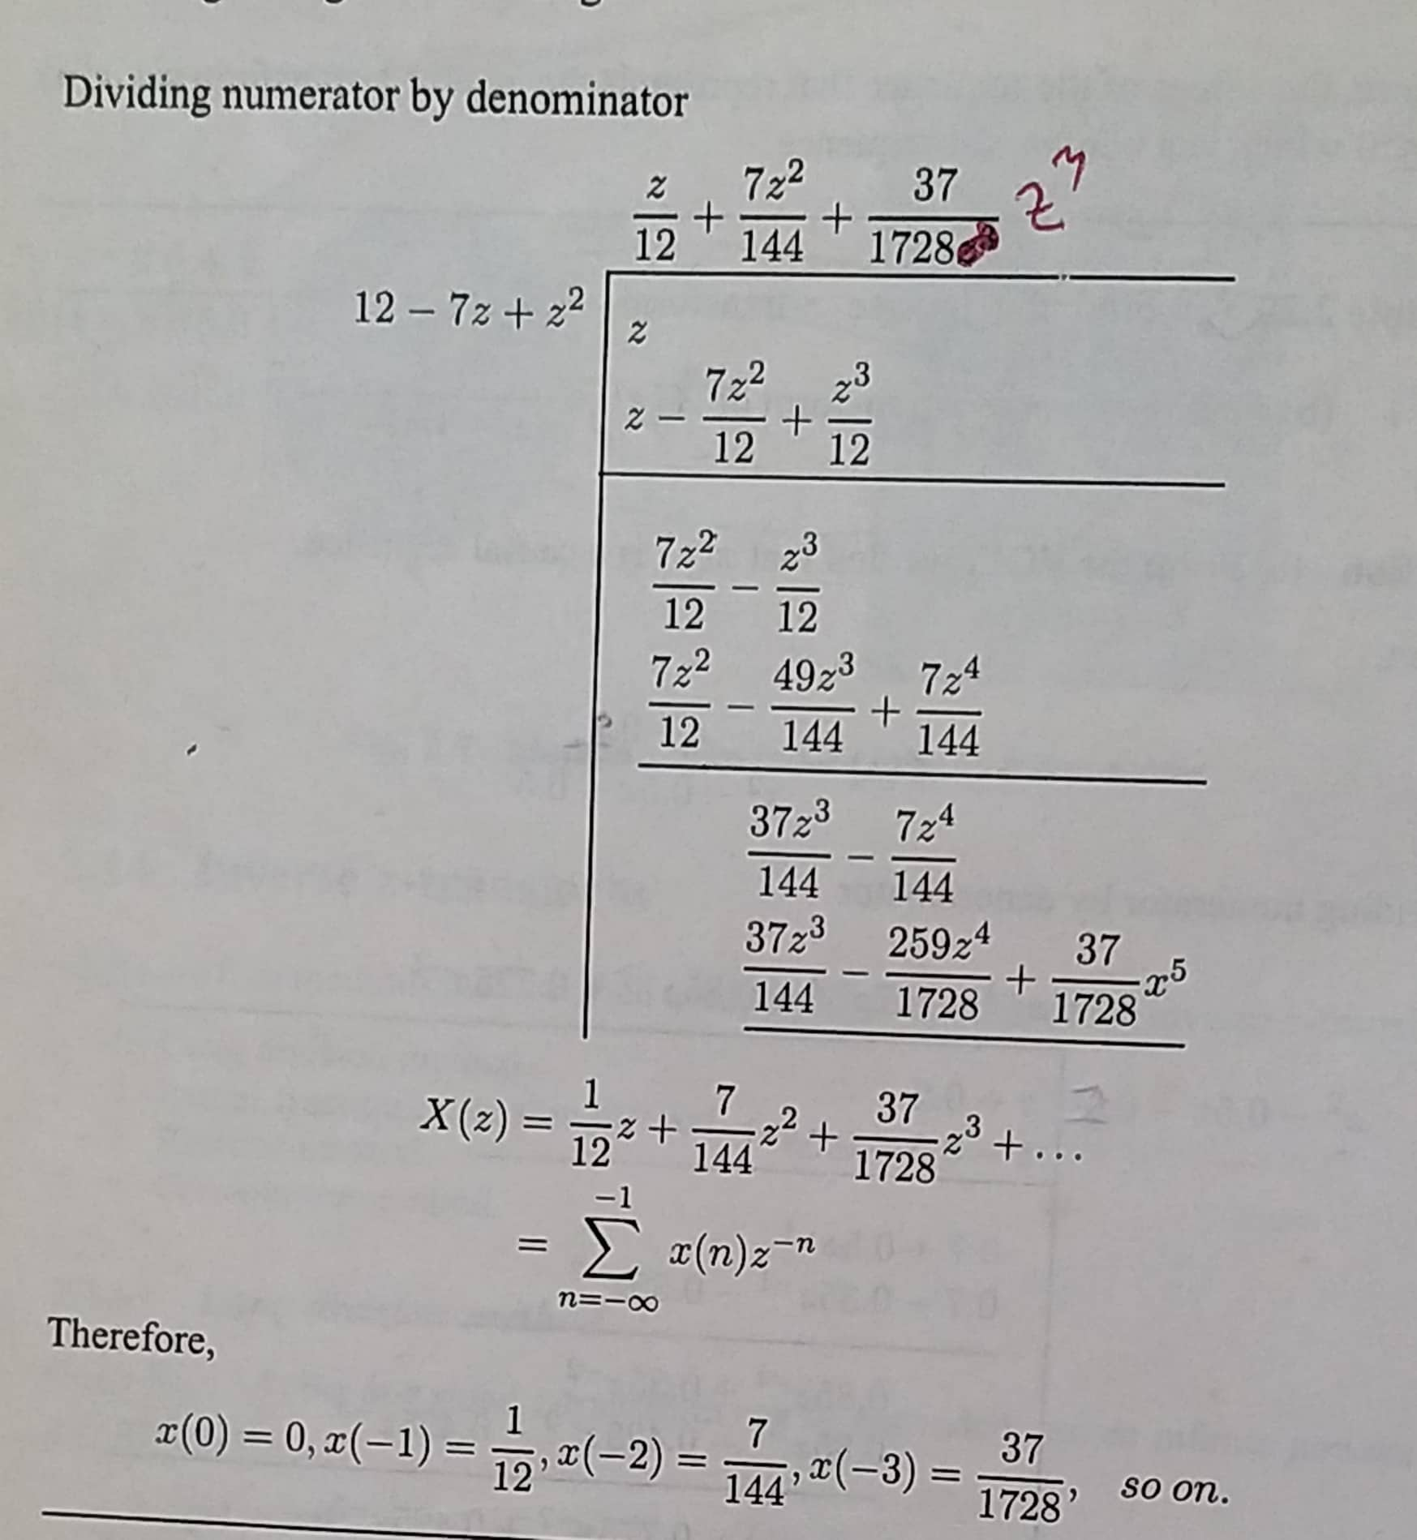
Inverse Z Transform by Long Division

Slide 43
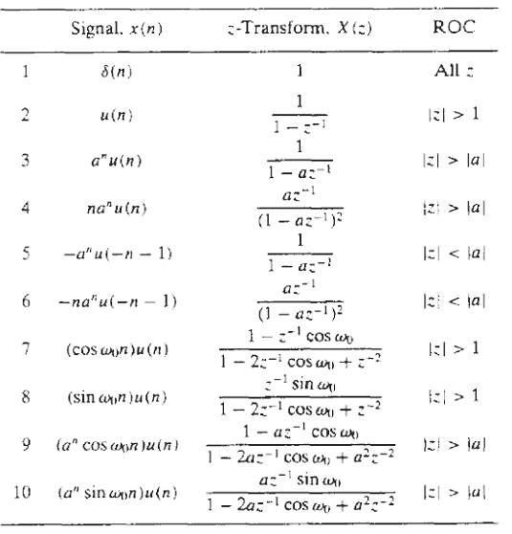
Inverse Z Transform by Partial Fraction Expansion
This technique uses Partial Fraction Expansion to split up a complicated fraction into forms that are in the Z Transform table as shown.

Slide 44


Inverse Z Transform by Partial Fraction Expansion
As an example consider the function
For reasons that will become obvious soon, we rewrite the fraction before expanding it by dividing the left side of the equation by "z.“

Slide 45
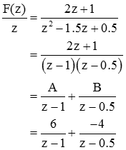
Inverse Z Transform by Partial Fraction Expansion
Now we can perform a partial fraction expansion

Slide 46

Inverse Z Transform by Partial Fraction Expansion
These fractions are not in our table of Z Transforms. However if we bring the "z" from the denominator of the left side of the equation into the numerator of the right side, we get forms that are in the table of Z Transforms; this is why we performed the first step of dividing the equation by "z.“
So,
Or,

Slide 47
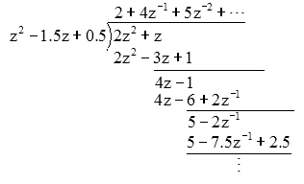
Example
Verify the previous example by long division.
So
and the sequence f[k] is given by

Slide 48
Inverse Z Transform by Partial Fraction Expansion
Find the inverse z-transform of

Slide 49
Inverse Z-Transform Using Transform Equation
Find the signal x(n) for which the z-transform is
i)
_{ii)}
_{iii)}
^{Solutions:}
We know inverse z-transform equation

Slide 50
Inverse Z-Transform Using Transform Equation
i)
Expanding X(Z) we get
The Z-Transform Equation is
Comparing equation (i) and (ii) as
we get

Slide 51
Inverse Z-Transform Using Transform Equation
ii)
Expanding X(Z) we get
The Z-Transform Equation is
Comparing equation (i) and (ii) as
we get

Slide 52
Inverse Z-Transform Using Transform Equation
iii)
Solution = ?

Slide 53
Thank You

